Slide 1

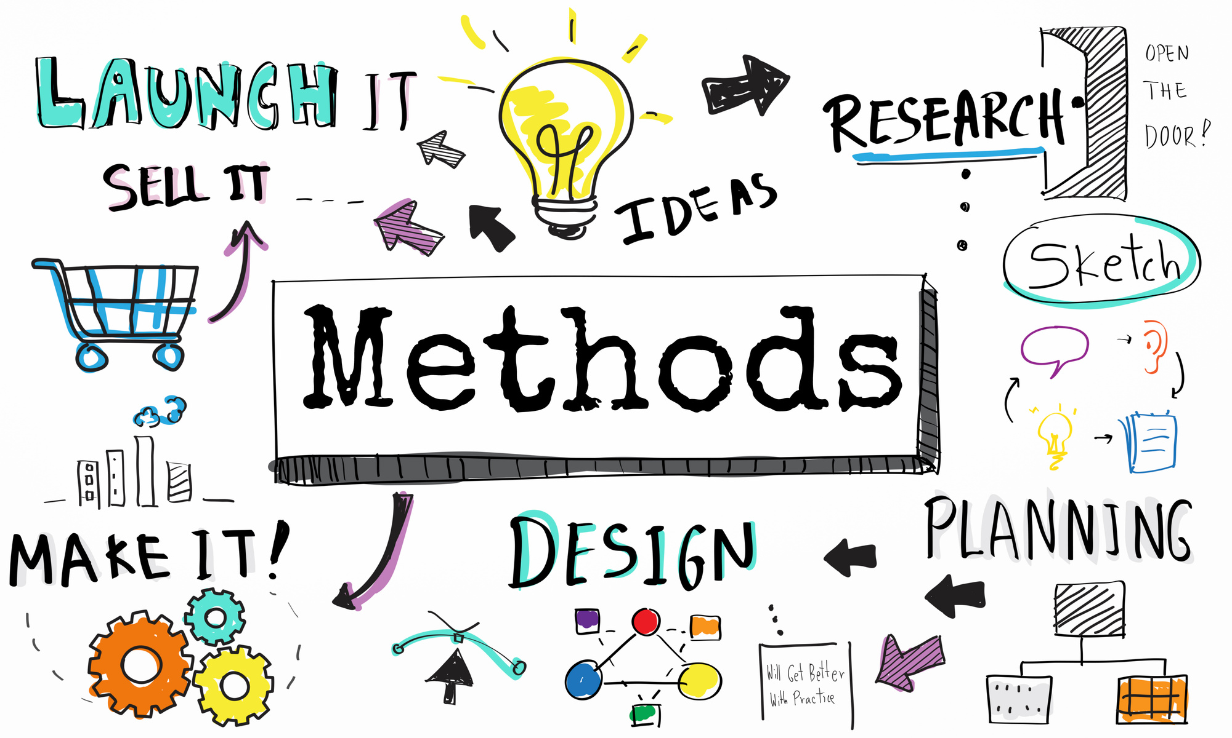
Part 2
Methods and Stratergies of Developing People
By Shihab Haque
ID: 24230115091

Slide 2


Considerations!

Slide 3
Considerations!
Each Context is Different from other
Each Individual is Different from other individual

Slide 4

Considerations!
Each Context is Different from other
Each Individual is Different from other individual
To Do
Not To Do

Slide 5

Individual Basis

Slide 6





Common Strategies and Methods for Individuals:
To Do
Skill Building
Taking Courses
Attending Seminars and events

Slide 7


Common Strategies and Methods for Individuals:
To Do
Self Reflection
Setting Smart Goals
Inward Analysis

Slide 8



Common Strategies and Methods for Individuals:
To Do
Networking
Seeking Feedback
Having Growth Mindset
& focus on Hard Skills

Slide 9



Common Strategies and Methods for Individuals:
To Do
Self Care
Overcome fears
Time management

Slide 10
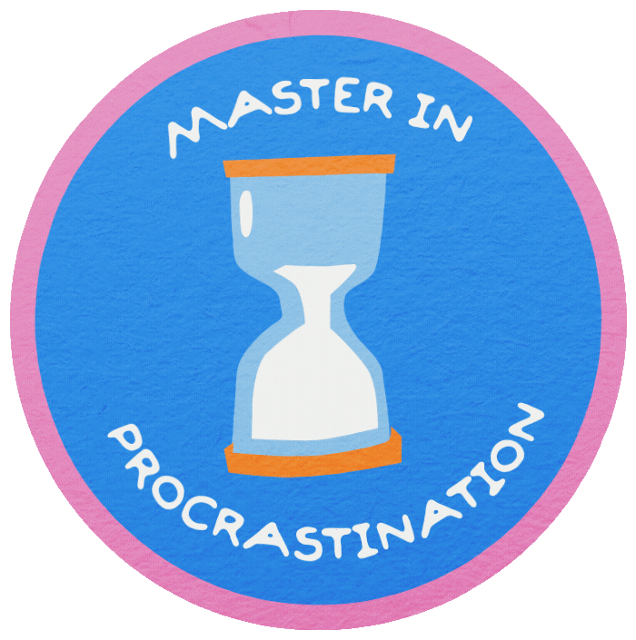
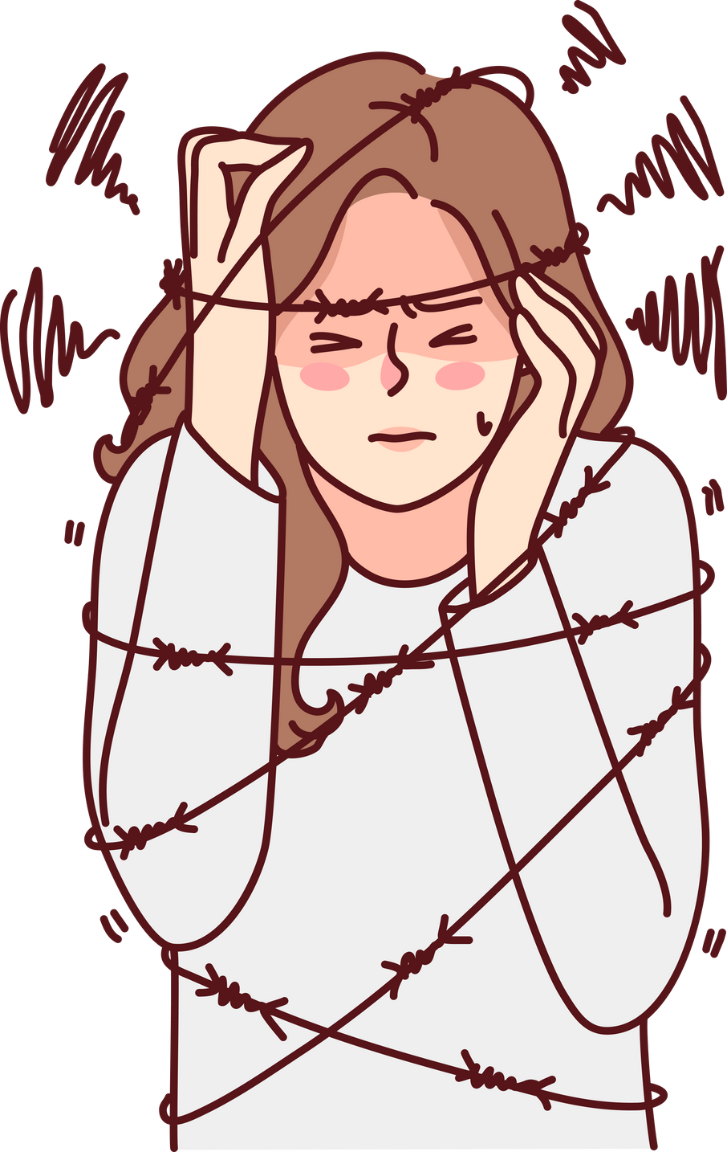
Common Strategies and Methods for Individuals:
Not To Do
Procrastination
Overthinking

Slide 11


Common Strategies and Methods for Individuals:
Not To Do
Ignoring feedback
Overloading

Slide 12

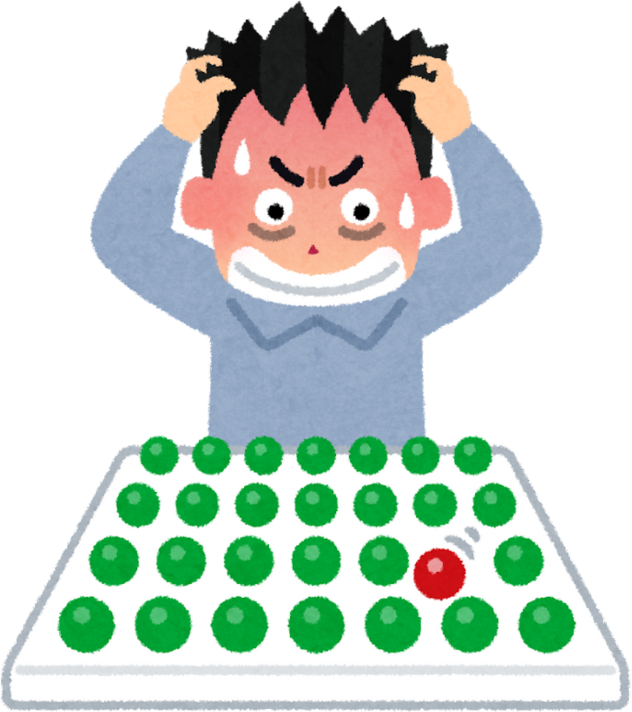
Common Strategies and Methods for Individuals:
Not To Do
Avoiding Risk
Seeking Perfection

Slide 13
Organizational Basis

Slide 14


Common Strategies and Methods for Organizations:
To Do
Training Programs
Workshops
Certifications

Slide 15


Common Strategies and Methods for Organizations:
To Do
Guidances & CD
Mentorship
Coaching

Slide 16



Common Strategies and Methods for Organizations:
To Do
Providing Supportive Work Culture
Recognizing and Rewarding
Providing Resources and Tools

Slide 17

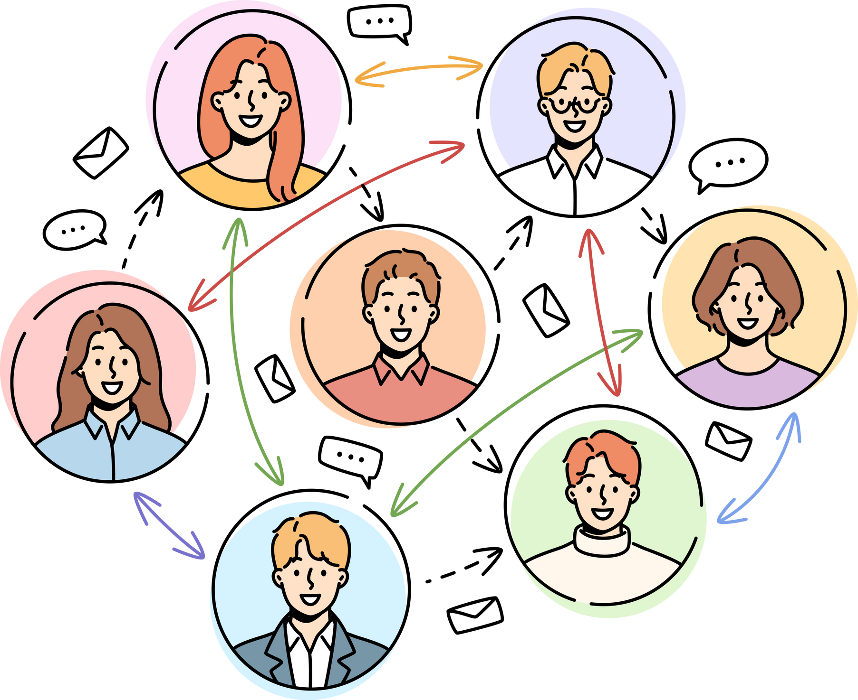
Common Strategies and Methods for Organizations:
To Do
Communication
Performance Reviews

Slide 18


Common Strategies and Methods for Organizations:
Not To Do
OverLoading Employees
Favoritism

Slide 19


Common Strategies and Methods for Organizations:
Not To Do
Inconsistency rewarding
Insufficient resources

Slide 20

Common Strategies and Methods for Organizations:
Not To Do
Disregarding feedback
Bias in evaluation

Slide 21
Challenges

Slide 22



Common Challenges:
Resistance to Change
Lack of Resources
Poor Communication

Slide 23


Common Challenges:
Short-Term Focus
Lack of Inclusivity

Slide 24
Solutions To those Challenges:
Discussed Previously!

Slide 25
Case Studiy

Slide 26

Case Study of
Before(Challenges and issues):
Rigid Hierarchical Structure
Low Employee Morale
Declining Market Relevance
Outdated Leadership Style

Slide 27




Case Study of
Methods Implemented:
Adopting a Growth Mindset
Investing in Training Programs
Recognizing Collaboration Over Competition
Providing Supportive Leadership

Slide 28

Case Study of
After Implementation:
A More Collaborative Culture
Improved Innovation
Increased Employee Satisfaction
Talent Retention and Attraction

Slide 29
For The Audience

Slide 30





For The Audience:
Fix Sleep Cycle
Start Learning New Skills
Avoid Short Contents

Slide 31

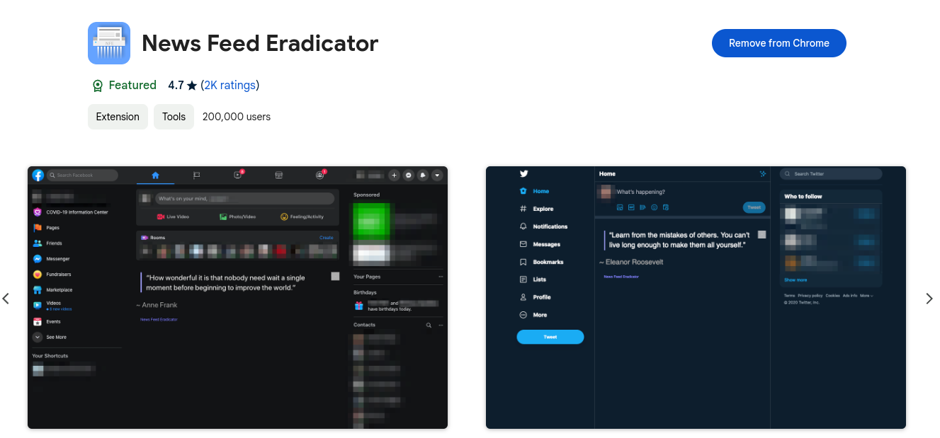

Tools for The Audience:
Second Brain
NewsFeed Eradicator
Digital Wellbeing and tracking

